Slide 1
Travel Posters
Landscape, townscape and design

Slide 2
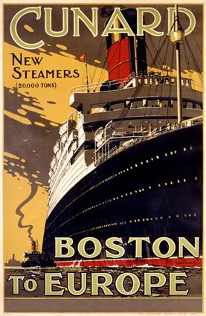

Slide 3
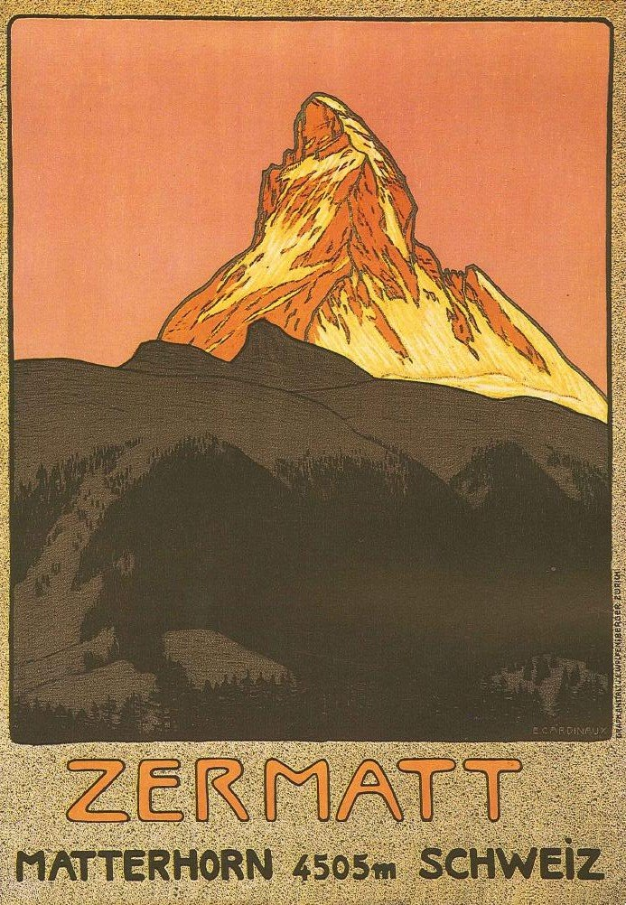

Slide 4
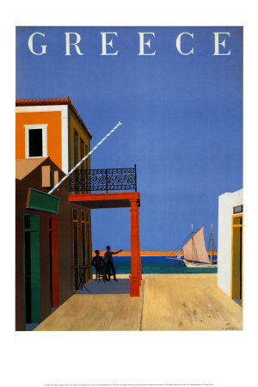

Slide 5
What is a Poster?
a sign posted in a public place as an advertisement;
A poster is an informative, often decorative way to attract attention to the information it contains.
A poster is where the researcher directly presents their research results as a visual display, which is positioned on poster board.
A poster is simply a static, visual medium (usually of the paper and board variety) that you use to communicate ideas and messages
Common Images
Ways of getting there – trains boats and planes
Scenery – towns, beaches, mountains, churches, castles

Slide 6
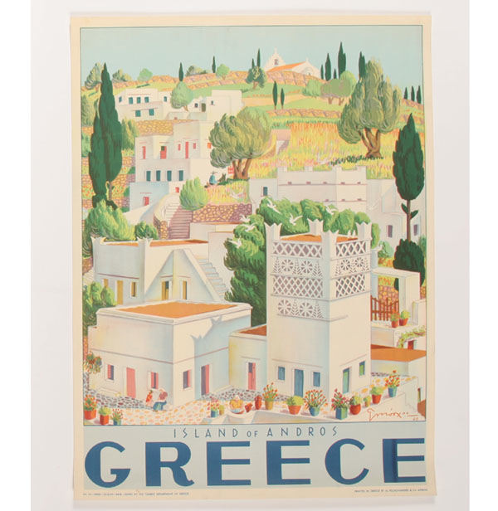

Slide 7
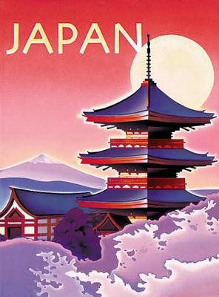

Slide 8
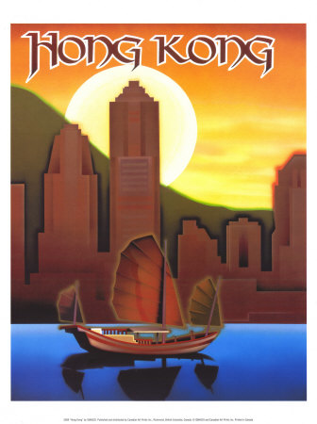

Slide 9
Key Elements
Exaggerated perspective leading your eye in
Little empty space
Simple colours
Appropriate style of lettering
Bold design
Attractive and inviting image
Flat colour
Clear lettering

Slide 10
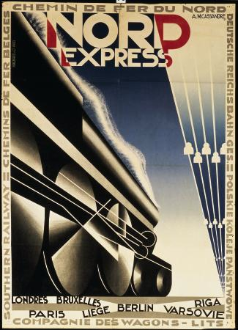

Slide 11
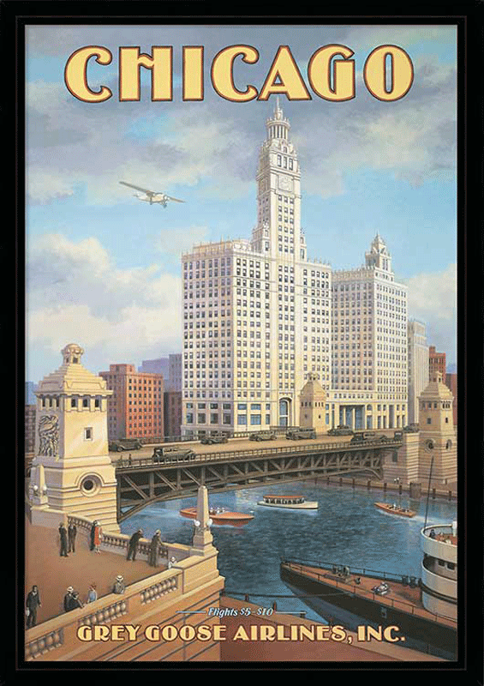

Slide 12
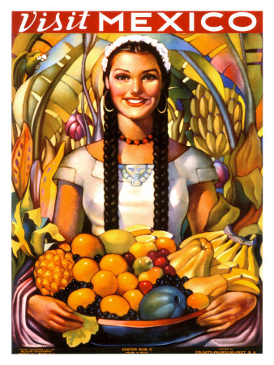

Slide 14
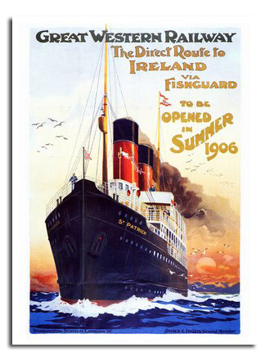

Slide 15
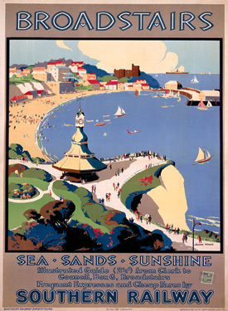

Slide 16
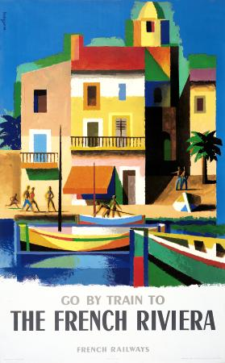

Slide 17
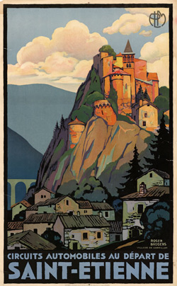
Simple shapes: flat greys and blues to show distance
Limited palette:
sunny colours - pink, orange, yellow
blues and greys
More detail: and texture
in the foreground
Bold lettering:
Pale blue to match the sky
filling the space across the bottom

Slide 18
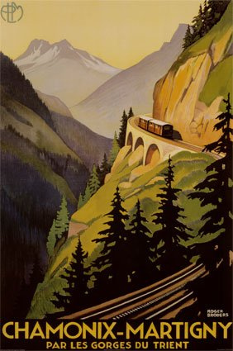

Slide 19
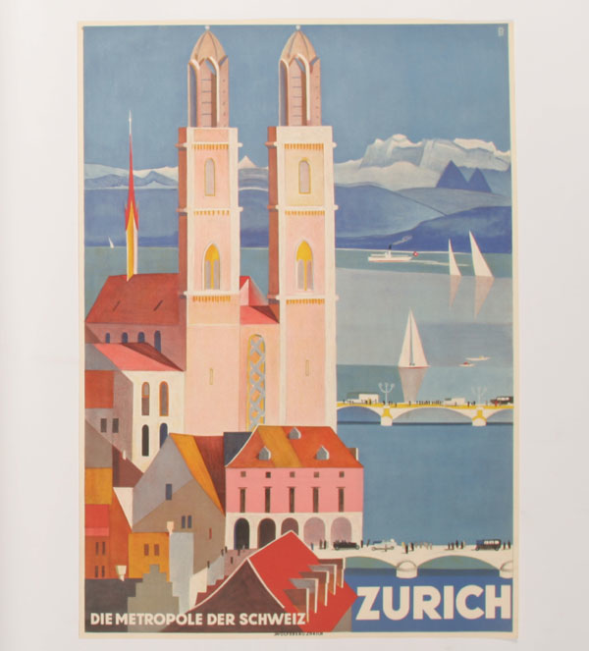

Slide 20
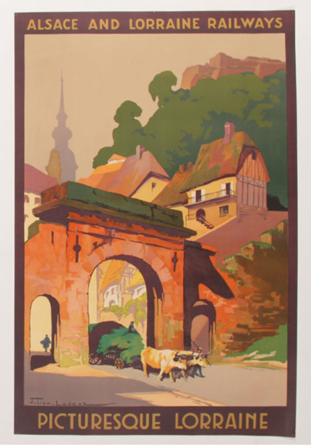

Slide 21
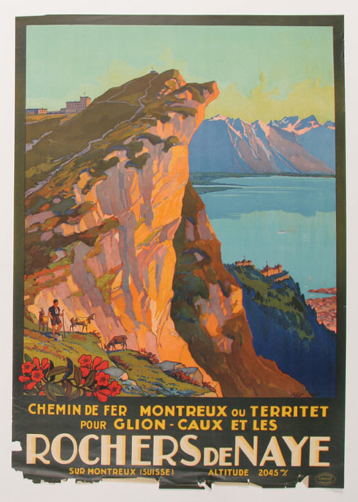

Slide 23
Lettering
Use a Ruler
rule top and bottom lines
line up horizontals
keep letters all the same width
Plan spacing
Choose a colour from the image
Keep it simple
not too many words
Effective lettering is essential for a good poster design

Slide 24
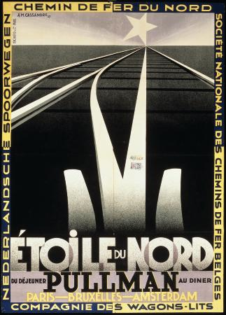

Slide 25
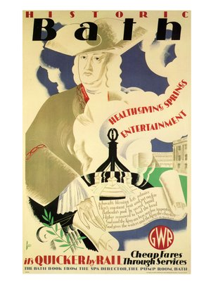

Slide 26
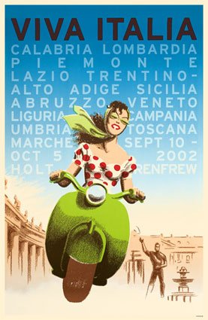
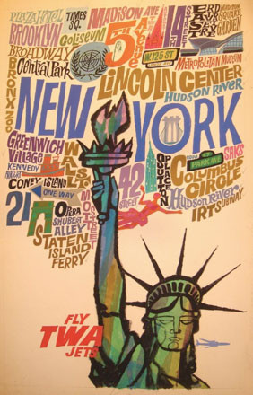

Slide 27
Your Tasks
Look at other examples
choose one and make a simple copy in your sketchbook
Decide the place you are going to advertise
choose somewhere you know
find pictures
Choose your wording
choose font/typeface
write it out
Research
Design ideas
Roughs/thumbnail sketches
Choose the best
Planning
Execution (doing it!)

Slide 28
I am looking for:
You are learning to:
Put words and images together
Draw out letters
Create a graphic design
Use colour to show distance
Evidence of your own original research
Bold designs
Clear well drawn lettering
Neat painting
Good use of perspective
Excellent presentation

